Slide 1
PROJECT ABOUT S.A.D.
Made by:Niko Ivančević Kovačević

Slide 2
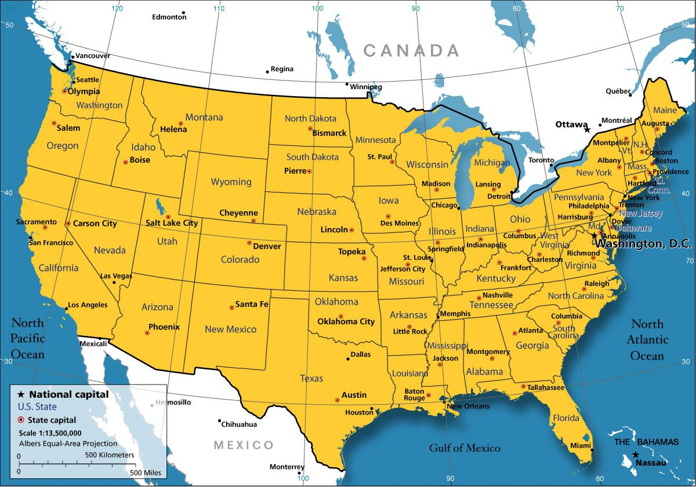
🎆USA🎆
United
States of
America
USA is a big country on the W(west)of the planet Earth,on the continent named North America(it´s not the only state on North America,there are Canada,Meksiko…).USA has got his own capital city,and that is Washington.(Here it is on the map[USA and Washington])

Slide 3
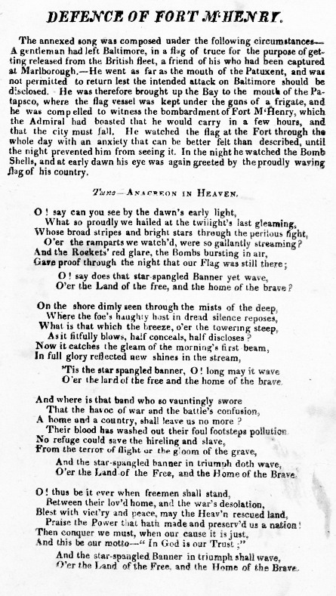

Slide 4
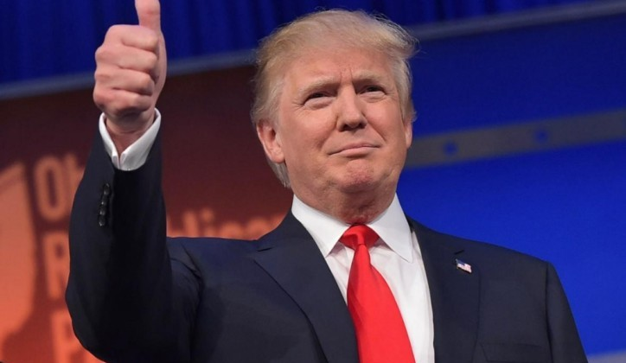
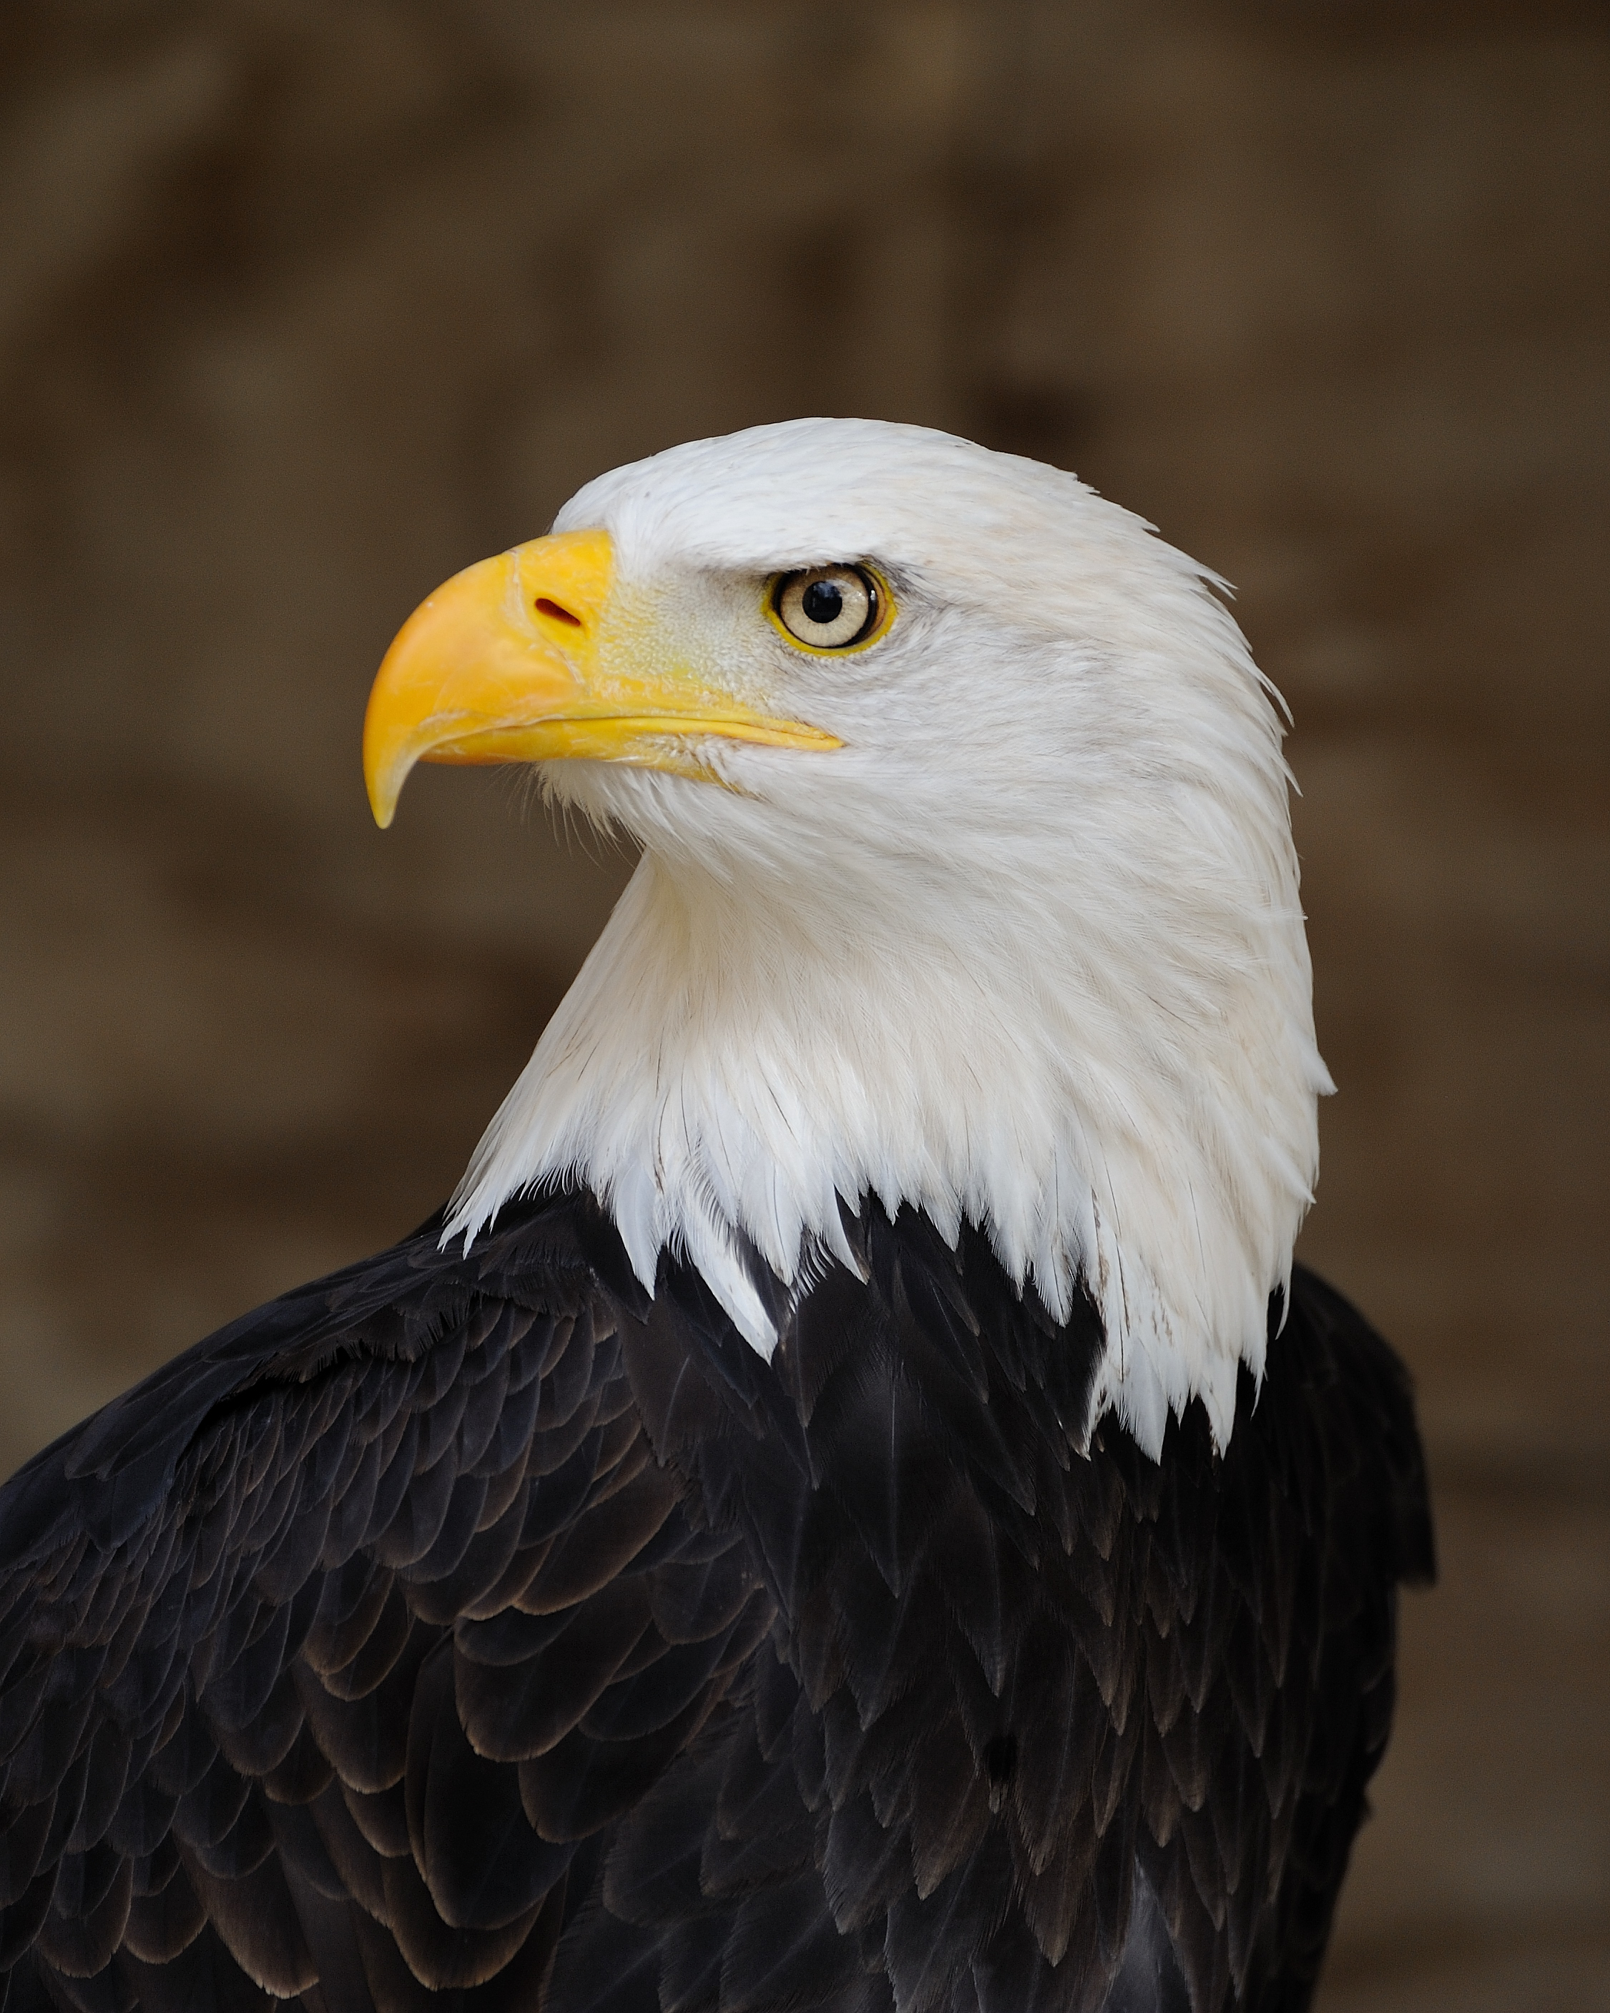
Flags,protected animals and president
USA´s flag looks like this here. The bald eagle has been the national bird of the United States since 1782.They have a president called Donald Trump.You can see him here.

Slide 5
HOLIDAYS
There are many holidays and celebrations in the USA .The federal holidays are:
January 1. New Year's Day
January 15.–21. (Floating Monday) Birthday of Martin Luther,King
February 15.–21. (Floating Monday) Washington's Birthday
March 29. National Vietnam War Veterans Day
May 25.–31. (Floating Monday) Memorial Day
July 4. Independence Day
September 1.–7. (Floating Monday) Labor Day
October 8.–14 .(Floating Monday) Columbus Day
November 11. Veterans Day
November 22.–28. (Floating Thursday) Thanksgiving Day
December 25. Christmas Day

Slide 6
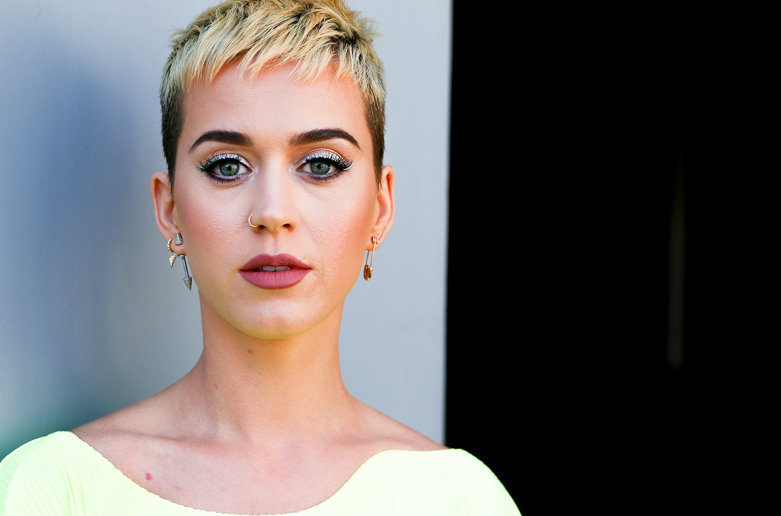
Music
USA has got many music artists.There(in USA)music is realy popular.The popular music artists are:
Taylor Swift,Justin Bieber,Katy Perry,Zara Larsson,ZAYN,Sia,Marshmello,Madonna,Clean Bandit.

Slide 7
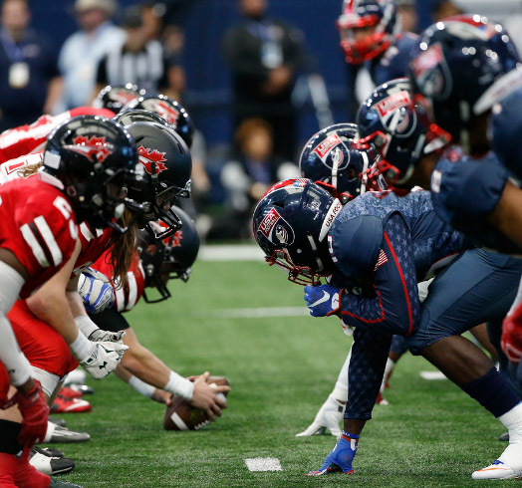
SPORT in USA
You see USA is very popular when you talk about their football.You see the picture of some USA football team and the competition.

Slide 8
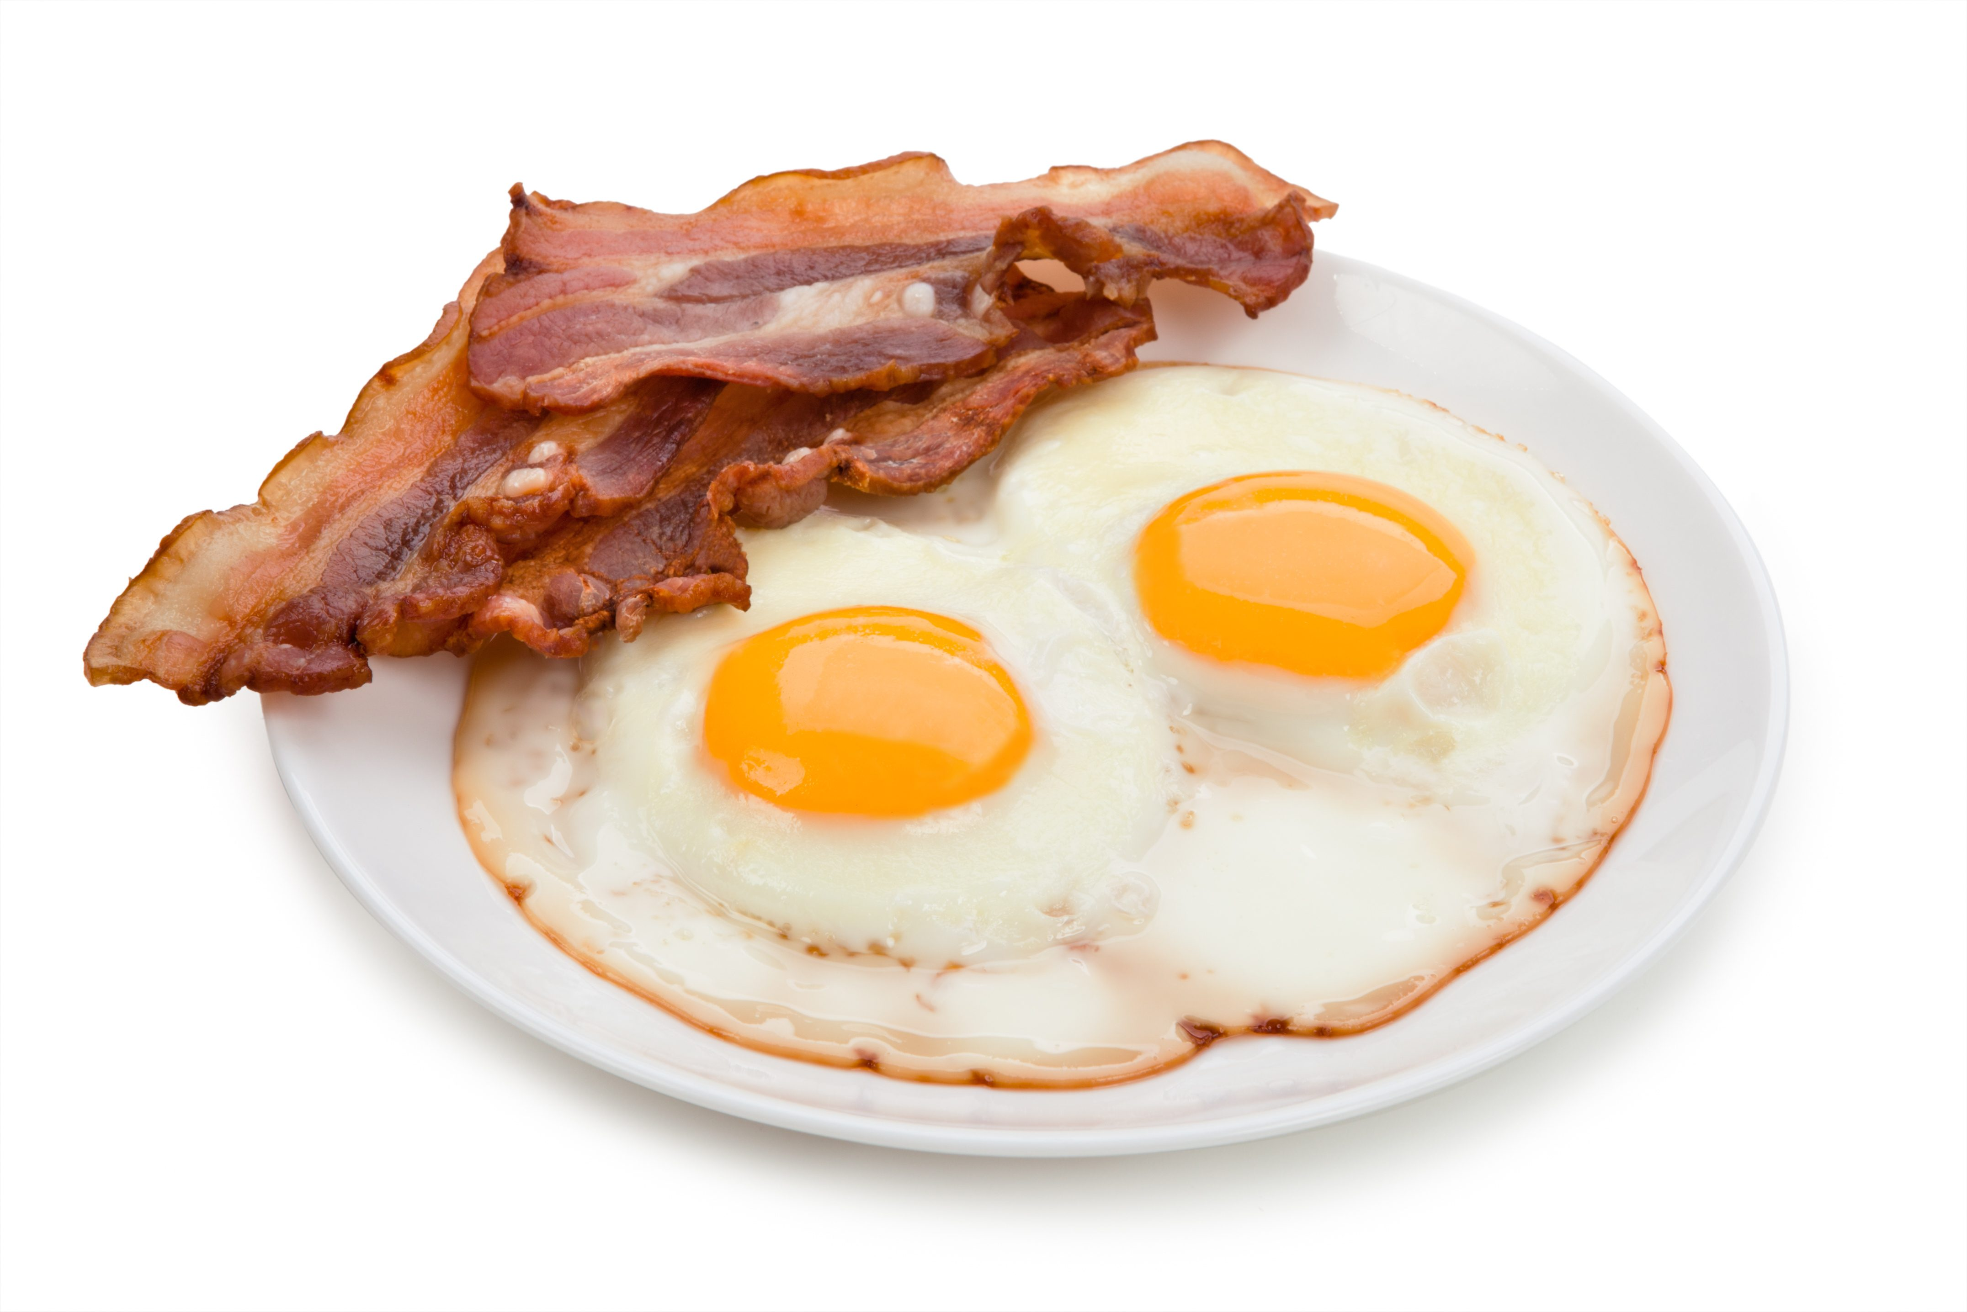
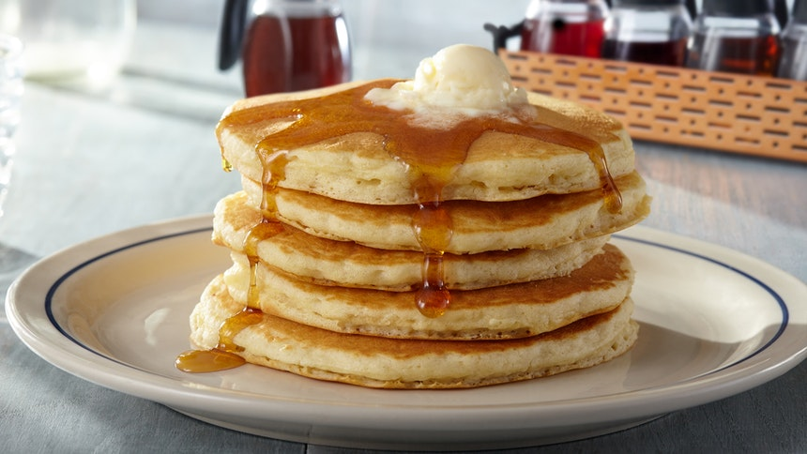
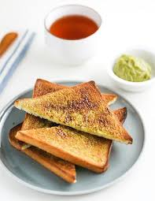
Food in USA
In USA pancakes are realy popular.American people eat pancakes for breakfast,so now were going to talk about American breakfast.
For breakfast American people usually have:pancakes,fried eggs with bacon or just a regular toast with something on it.

Slide 9
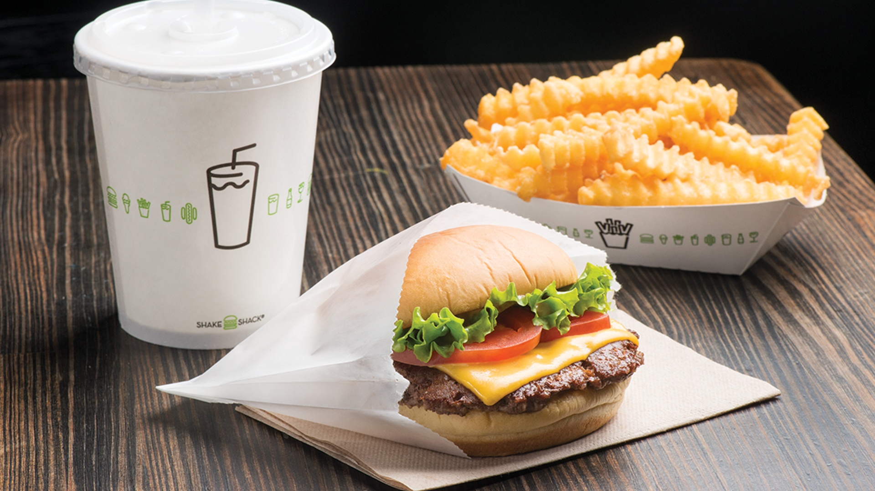
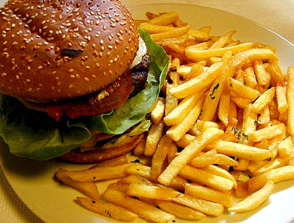
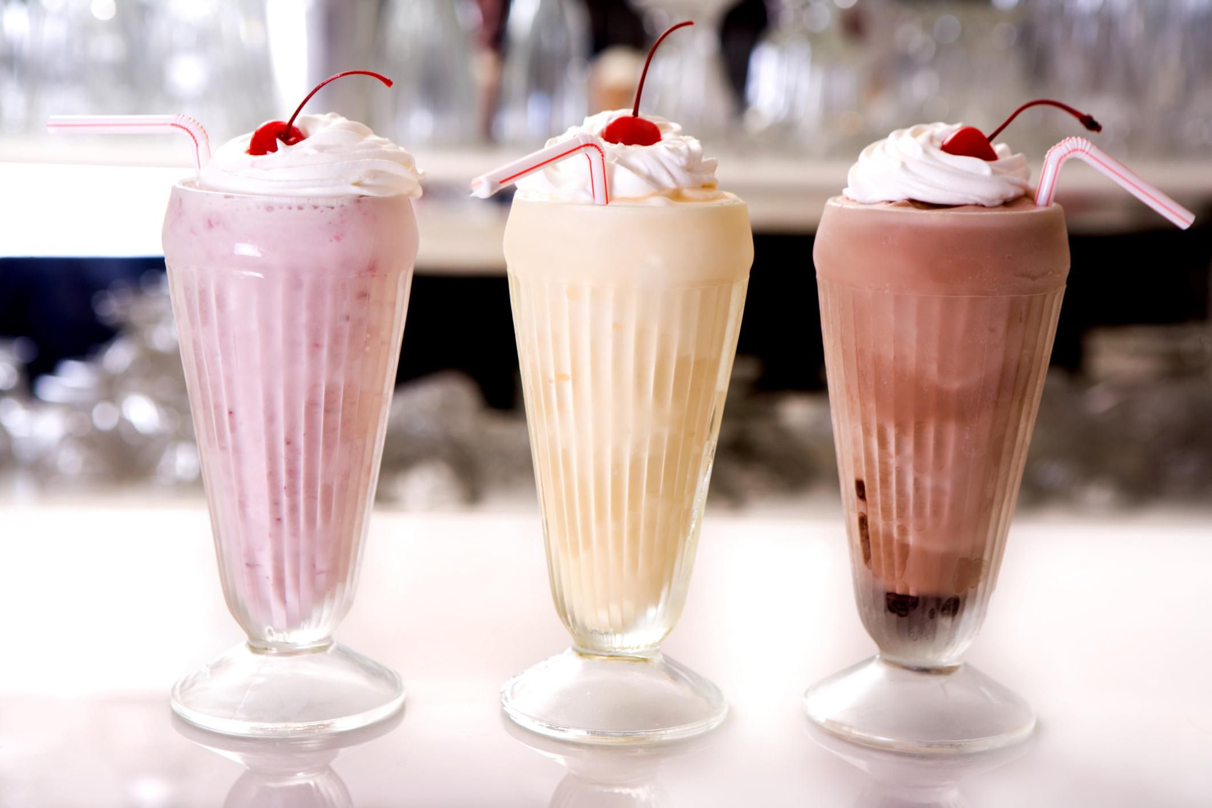
Food in USA
On the picture you can see a hamburger with some fries.That food is REALLY POPULAR in USA.You can eat it with some shake(milkshake).

Slide 10
Angela Ricky(wife of the killed)
Denis Ricky(son of the killed)
Clara Ricky(mother of the killed)
Rose Kentucky(Denis´s girlfriend)
Cameron Ricky
Cameron died yesterday in the living room at 10:00.Here is the list of those who were in the house.You will now read texts with the clues to the murder,and then you will try to find out who is the murder.GOOD LUCK WITH THE CASE!!!

Slide 12
Angela Ricky(wife of the killed)
Detective:What were you doing at 10:00?
Angela:I just got home when the case happened.
Detective:From were did you came?
Angela:From my job.I work as a vet.
Detective:What did you do when you heard a scream?
Angela:I quickly dropped things and ran to the living room.
Detective:Did you saw anyone suspected?
Angela:No,I didn´t.
Detective:Ok,please call Denis Ricky.

Slide 13
Denis Ricky(son of the killed)
Detective:What were you doing at 10:00?
Denis:I was cleaning my room upstairs.
Detective:What were you doing when you heard a scream?
Denis:I quickly turned off the vacuum cleaner and ran downstairs.
Detective:Did you saw anyone suspected?
Denis:I saw my girlfriend running in the bathroom.
Detective:Ok,thank you Denis.

Slide 14
Clara Ricky(mother of the killed)
Detective:What were you doing at 10:00?
Clara:I was in the kitchen making a breakfast.
Detective:What were you doing when you heard a scream?
Clara:I didn´t ran because I can´t run so I walked as fast as I can to the living room.
Detective:Did you saw anyone suspected?
Clara:I saw Denis girlfriend Rose.She was carrying something glittering in her hands and that’s it.
Detective:Thank you,Clara.

Slide 15
Rose Kentucky(Denis´s girlfriend)
Detective:What were you doing at 10:00?
Rose:I was preparing the table in the dining room.
Detective:What were you doing when you heard a scream?
Rose:I ran in the bathroom.
Detective:Why there?
Rose:Because I had to strain my nose(napudrati nos)!
Detective:Ok,thank you.

Slide 16
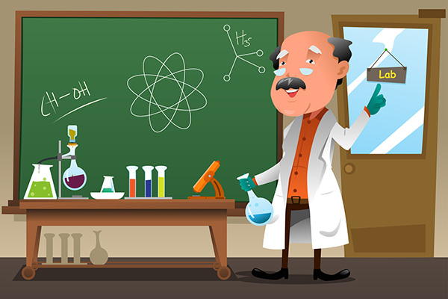
Angela Ricky(wife of the killed)
Denis Ricky(son of the killed)
Clara Ricky(mother of the killed)
Rose Kentucky(Denis´s girlfriend)
Cameron Ricky
Now try to find out who is the murder.
YOU HAVE 10 SECOND FOR THINKING.
Did you find out who is the murder?
Ok,I will show you on my plan.
THINK!

Slide 17
Rose is the murder.
When she was
carrying something
she killed Cameron,
because she wanted
all the money from
Cameron!

